Slide 1
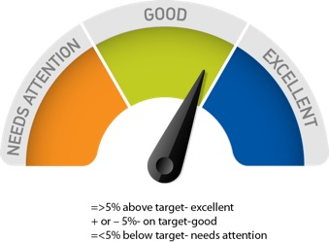
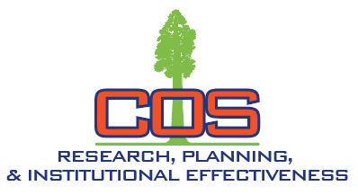
Institution-Set Minimum Standards & Stretch/Aspirational Goals
Mehmet "Dali" Ӧztürk, Ph.D.
Dean, Research, Planning & Institutional Effectiveness
May 2025 (Participatory Governance)
September 2025 (Board of Trustees)

Slide 2


ACCJC Guide to Evaluating and Improving Institutions
What criteria and processes does the college use to determine its priorities and set minimum expectations (institution-set standards) for student achievement, including required expectations of performance for course completion, job placement rates, and licensure examination passage rates? (Federal Regulation)
To what extent does the college achieve its standards? (Federal Regulation)
How does the college use accreditation annual report data to assess performance against the institution-set standards?
If an institution does not meet its own standards, what plans are developed and implemented to enable it to reach these standards? (Federal Regulation)
Stretch Goals

Slide 3

Student Achievement Data Requested by ACCJC
District level
Course Completion Rate
Student Certificate Completion
Student Degree Completion
Student Transfer to 4-year Colleges/universities

Slide 4
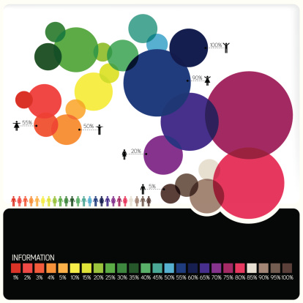
Methods for Setting and Using the Standards
    Reasonable
    Appropriate
    Realistic

Slide 5
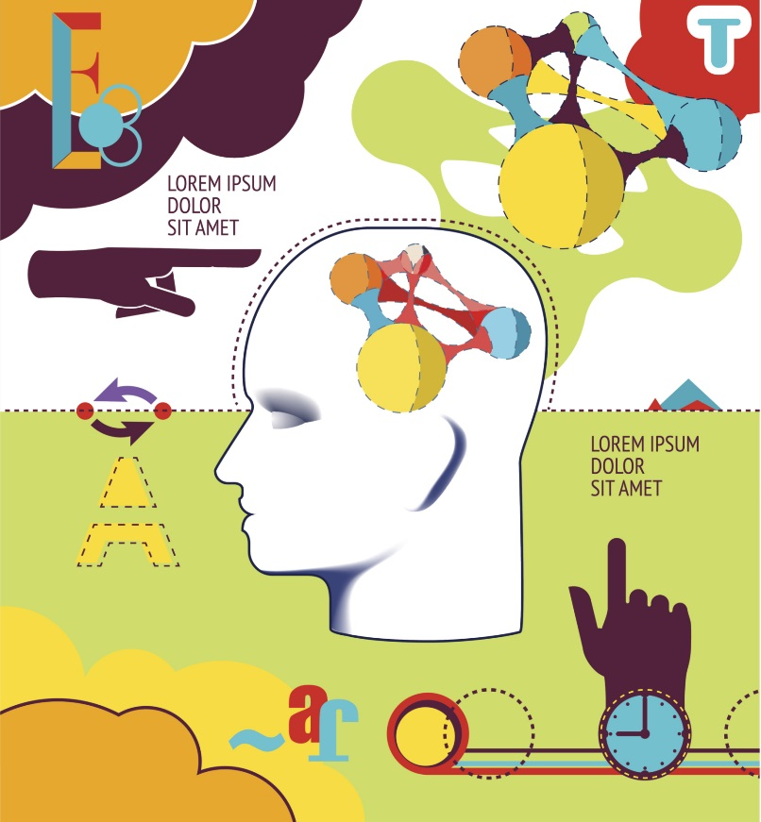
Proposed Method for Setting the Standards
  Review most current and historical performance (multi-year/longitudinal data disaggregated by ethnicity and other demographic characteristics as appropriate)
  Generate multi-year averages for performance (5-8 years)
  Determine performance indicators based on data analysis, institutional history and context (standards)

Slide 6
Proposed Method for Using the Standards
  Develop a performance range and/or color coding (Trapp, 2013):
  Range
    =>5% Above Target-Excellent
    + or – 5% On Target-Good
    =<5% Below Target-Needs Attention

Slide 7
Proposed Standards
Method
Percentage of 6-year overall
Aspirational
Minimum
March/April 2018

Slide 8
Student Achievement Data Requested by ACCJC
District level
Course Completion Rate
Student Certificate Completion
Student Degree Completion
Student Transfer to 4-year Colleges/universities
Notes:
Short version starts here

Slide 9

Proposed Standards
March/April 2018
Notes:
Multi Year: 2012-2017
Baseline Year: 2017

Slide 10


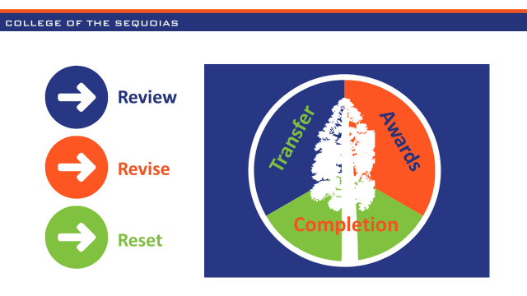
Institution-set Standard Recommendations
and Outcomes
Student Achievement Area | Multi-Year District Average | Min. Std. | Stretch or Asp. Goal | Baseline Year 2017 | Reported Year 2018/19 | Reported Year 2019/20 | Reported Year 2020/21 | Reported Year 2021/22 | Reported Year 2022/23
Course Completion Rate | 70% (Fall 12-17) | 67% | 74% | 71% | 74% | 74% | 82% | 68% | 70%
Student Degree Completion | 929 (2012-17) | 883 | 1,068 | 1,054 | 1,335 | 1,537 | 1,495 | 1,444 | 1,457
Student Transfer to 4-Year Colleges/Univ. | 920 (2010-2016) | 828 | 1,012 | 852* | 916 | 1,025 | 1,057 | 968 | 930
Student Certificate Completion | 543 (2012-17) | 489 | 652 | 711 | 838 | 736 | 749 | 667 | 978
Baseline Years
Course Success: Fall 2017
Degree Completion: 2017
*Student Transfers: 2015-16
Certificate Completion: 2017
Minimum Standard Met
Aspirational Standard Met

Slide 11
Institution-set Standard Recommendations
and Outcomes
Student Achievement Area | Minimum Standard | Stretch or Aspirational Goal | Reported Year 2023/24
Course Completion Rate | 67% | 74% | 72%
Student Degree Completion | 883 | 1,068 | 1,631
Student Transfer to 4-Year Colleges/Univ. | 828 | 1,012 | 935
Student Certificate Completion | 489 | 652 | 660
Minimum Standard Met
Aspirational Standard Met

Slide 12
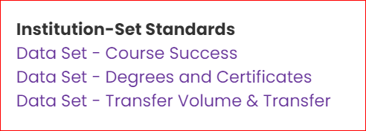
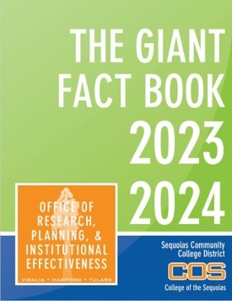
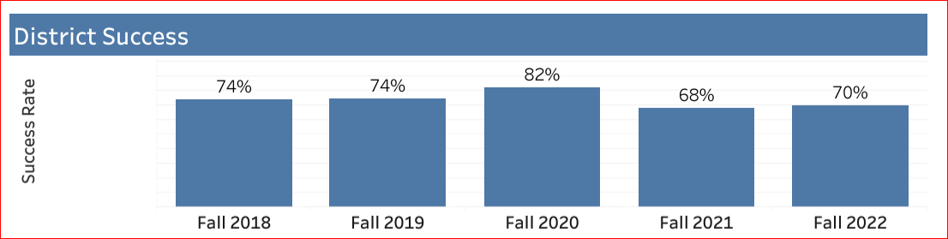
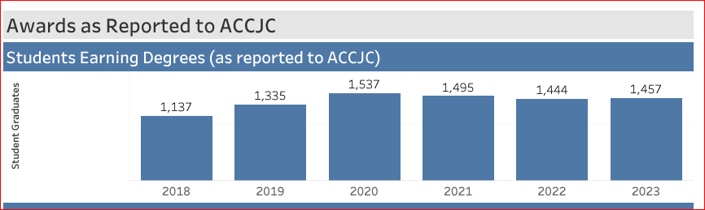
COS.EDU/FACTBOOK

Slide 13

NEXT STEPS

Slide 14
Follow participatory governance structure
Review & Discussion
Where/Who (participatory governance group) | When
Academic Senate (by Ozturk) | May 14, 2025
District Governance Senate (by Ozturk) | May 13, 2025
Senior Management (by Ozturk) | May 8, 2025
Board of Trustees (by Calvin) | September 8, 2025

Slide 15


Thank You!
www.cos.edu
www.cos.edu
Questions

